Slide 1

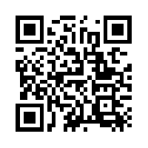
Quantum Communications Group
Key Management Layer
ITU-T Y.3803
Group Coordinator:
Armando Nolasco Pinto
anp@ua.pt
Diogo Matos
Group Websites:
https://www.it.pt/Groups/Index/72
LinkedIn: https://www.linkedin.com/company/quantum-communications-group-it-av/

Slide 2
GOAL
Make a description of key management for a QKDN.

Slide 3
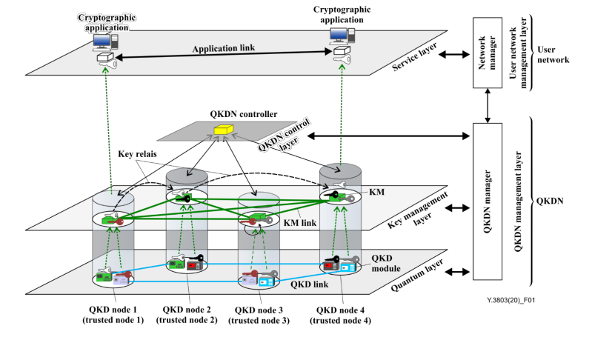
Basic key management operations in a QKDN

Slide 4
Main entities
KMA (Key Management Agent) - it receives keys from QKD modules, and interconnects the QKD nodes by key relay;
KSA (Key Supply Agent) - interfaces with the cryptographic application, realizing the function of key supply;
QKDN controller - it’s located in a quantum key distribution (QKD) network control layer to control a QKD network

Slide 5
KEY ACQUISITION & AUTH & STORAGE
KMA receives QKD-key file (key material + metadata) and stores it in a temporary buffer;
One KMA of the pair sends to the matching KMA a key authentication request by sending the hash value of the key file and the key id;
The other KMA compares the hash value with the one computed by itself. If the code coincide with each other, sends a successful auth message back;
Both store the buffered keys as key data.
NOTE - A similar process is necessary (because of the possibility of error on the key relay) between KSA’s before providing the key to the apps.

Slide 6
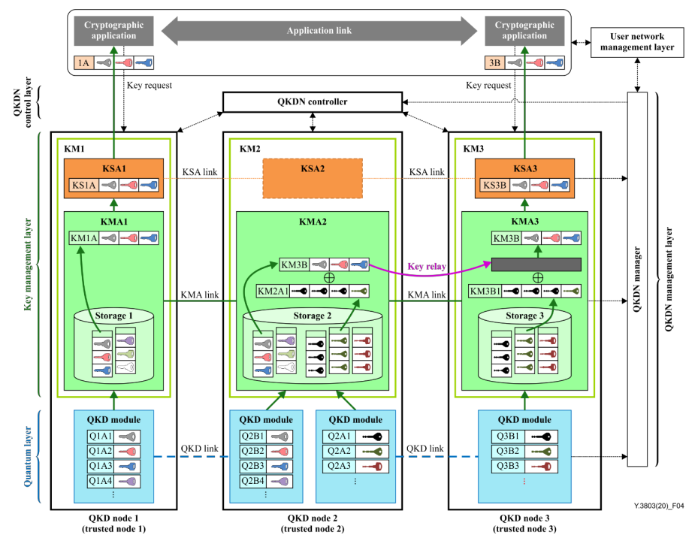
Key relay
Alice and Bob might be in different QKDN nodes that don’t share any QKD module (KM1 and KM3 respectively).
Key relay need to happen because the two KMA’s don’t share the same key source.
Process managed by the QKDN controller

Slide 7
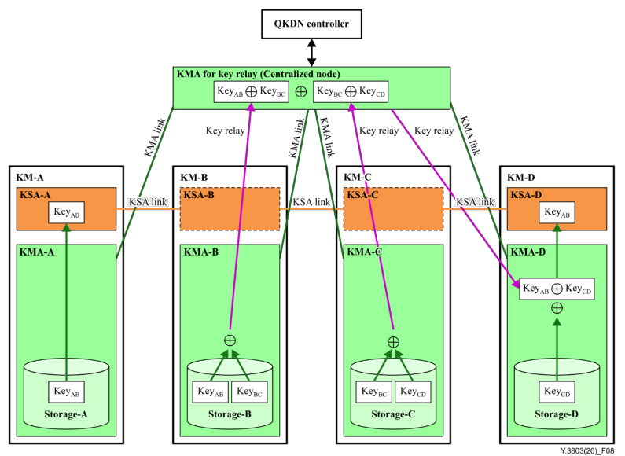
Key relay - centralized key relay node solution

Slide 8
Interesting points that complement ETSI’s specifications
Key-authentication both in the QKD source and in the KSA
Authentication between KMA & KSA
Key relay
QKDN controller to provide peer discovery

